Slide 1

Let’s Connect using
Presentation template by SlidesCarnival

Slide 2
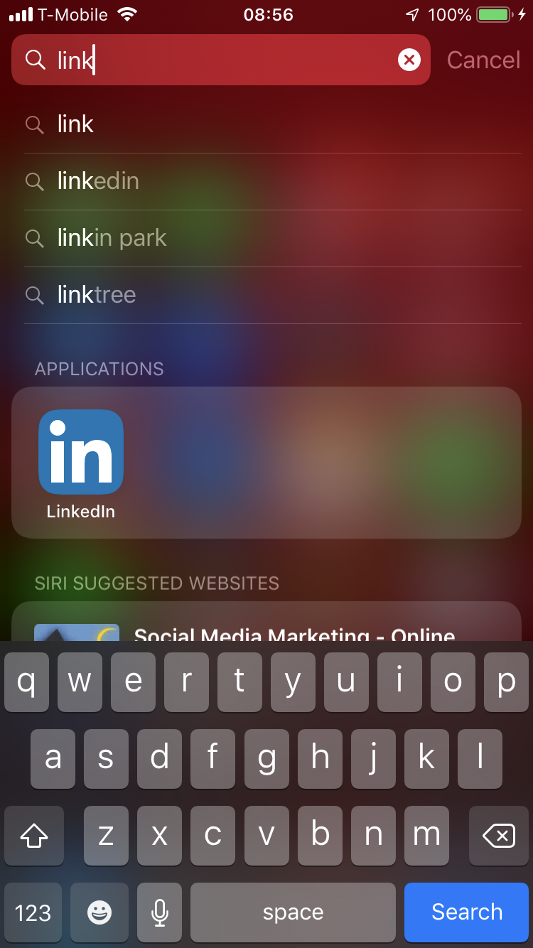
Place your screenshot here
1.
Open Linked IN.

Slide 3
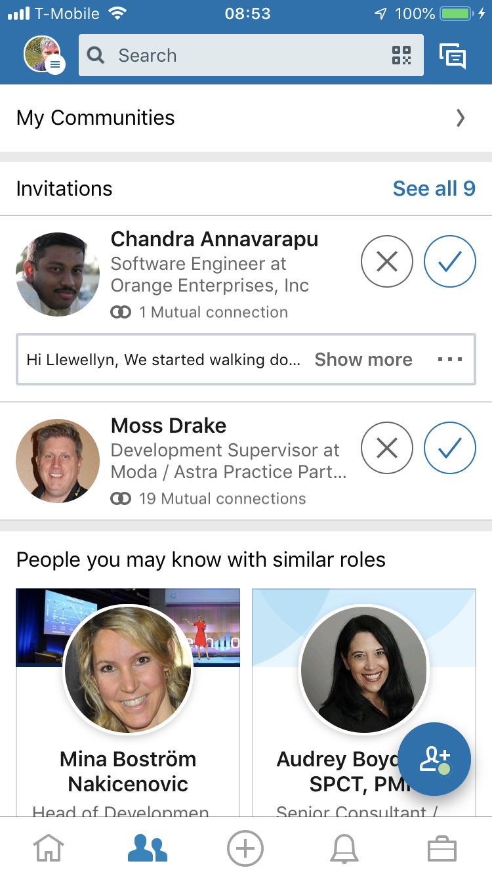
Place your screenshot here
2.
Select My Network

Slide 4
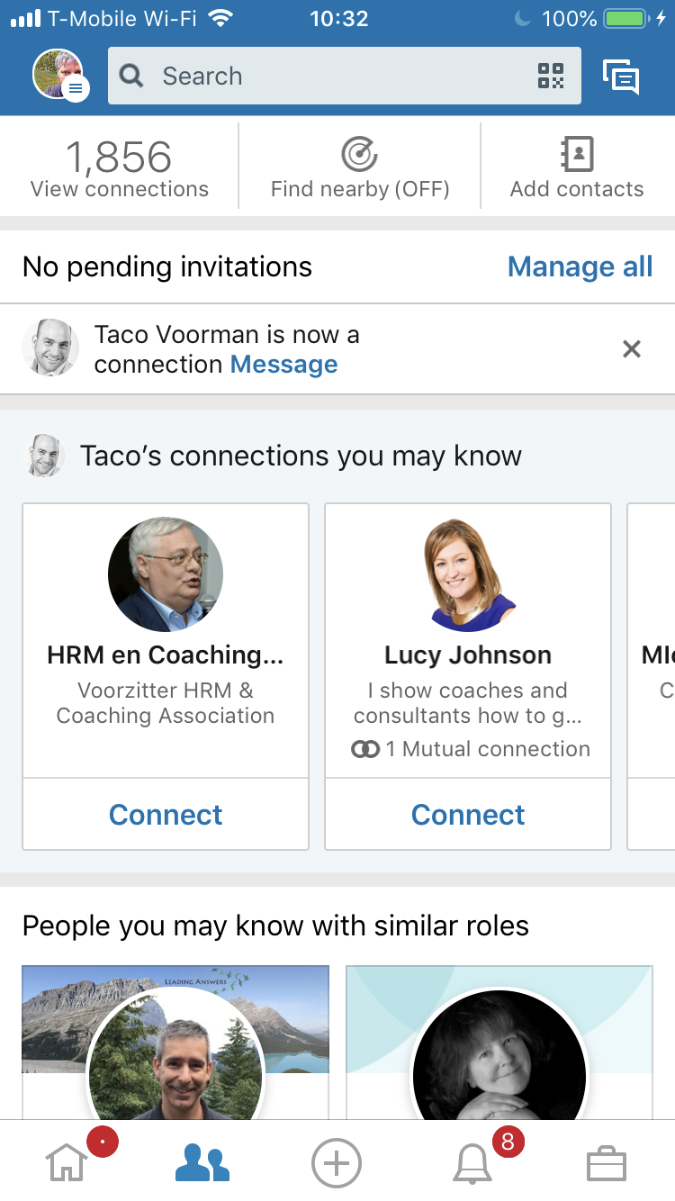
Place your screenshot here
3.
Turn on Find Nearby

Slide 5
OR

Slide 6
Place your screenshot here
3.
Select Add Button

Slide 7
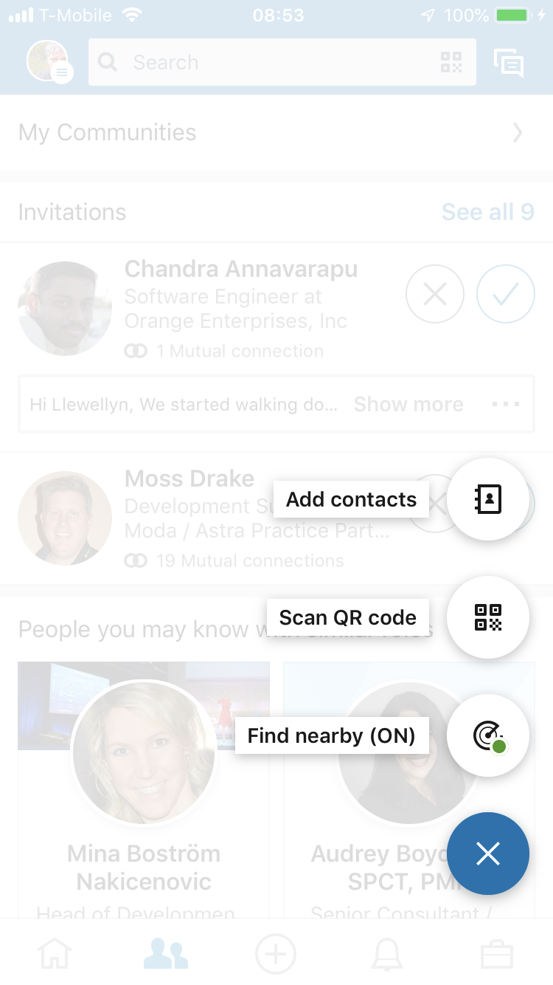
Place your screenshot here
4.
Select Find Nearby

Slide 8
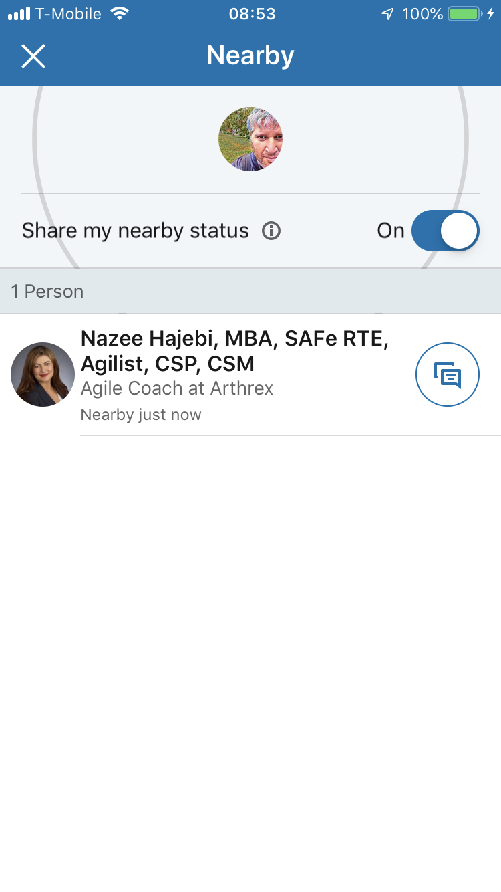
Place your screenshot here
5.
Turn On & Connect
( + for add Contact,
Message for already connected )

Slide 9
Let’s Connect
Open
My Network
Add Button
Find Nearby
Turn On & Connect

Slide 10
SlidesCarnival icons are editable shapes.
This means that you can:
Resize them without losing quality.
Change fill color and opacity.
Isn’t that nice? :)
Examples:

Slide 11
Extra graphics

